Slide 1

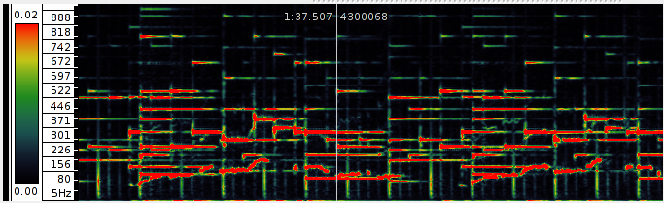
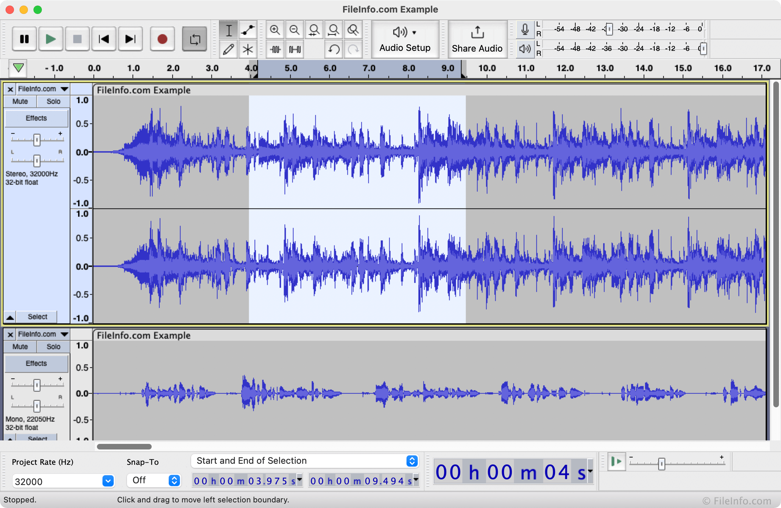
Go, change the world
RV College of
Engineering
Linear Integrated Circuits and Applications – Experiential Learning Phase - II
TOPIC:
Programmatic Simulation of Digital Filters for Audio Applications

Slide 2

RV College of
Engineering®
Team Introduction
Go, change the world
Roll No. | USN | Name | Email Id
1. | 1RV22ET005 | ARUN K R | arunkr.et22@rvce.edu.in
2. | 1RV22ET062 | YASHAS KASHYAP | yashaskashyap.et22@rvce.edu.in
3. | RVCE23BTE401 | S R SREEJITH | srsreejith.et23@rvce.edu.in
4. | 1RV22ET016 | CHIRANTHAN BHARADVAJ B | chiranthanbb.et22@rvce.edu.in

Slide 3
Execution in Phase-2
Implementing the open source library called “LibSoX”. Its Source Code is available on Github.
Creating our own audio files (at least 100 files) using ‘sox’ command and bash scripting.
Mixing multiple files to create a mixed frequency audio files. The files vary in parameters like volume, type of waveform (sin, sawtooth), no. of channels etc.
Writing code for digital filters like low pass, high pass, band pass and band reject filters.
Passing mixed frequency files as input to these digital filters and storing output in separate files.
Analysing frequency spectrum of these output files on software tool “Audacity”.

Slide 4
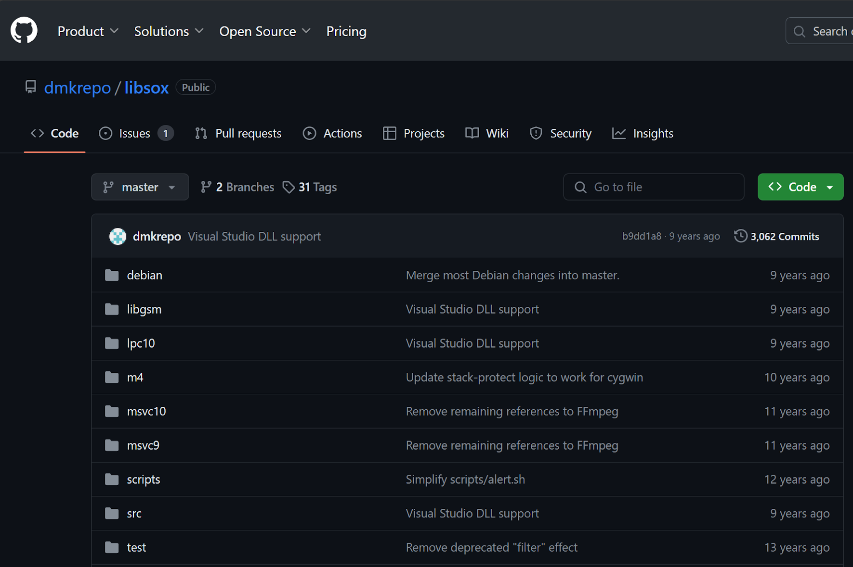
Execution in Phase-2
GITHUB REPOSITORY OF “LIBSOX” :-

Slide 5
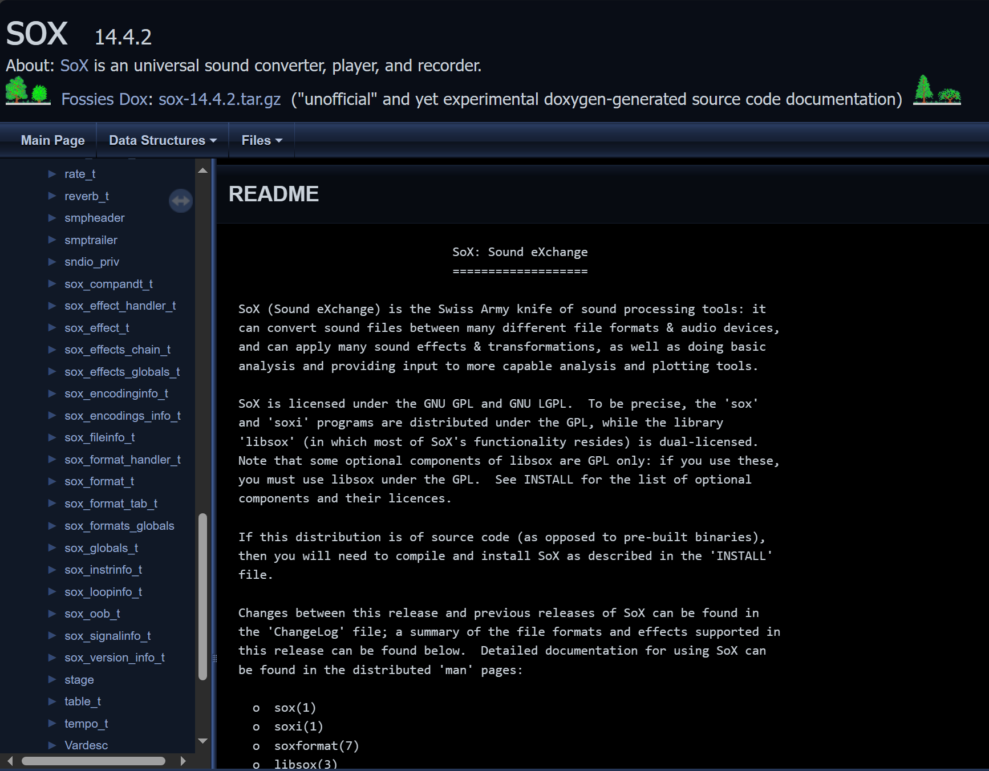
Execution in Phase-2
DOCUMENTATION OF “LIBSOX” LIBRARY :-

Slide 6
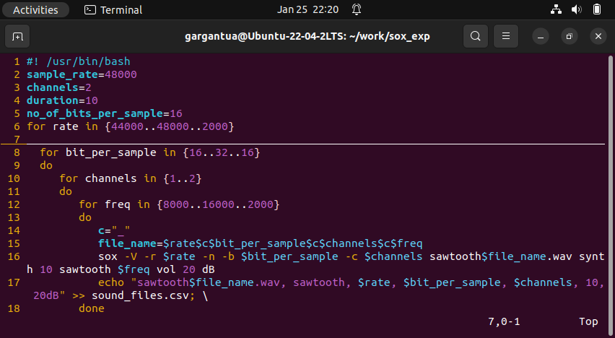
Execution in Phase-2
BASH SCRIPT FOR CREATING MULTIPLE FILES :-

Slide 7
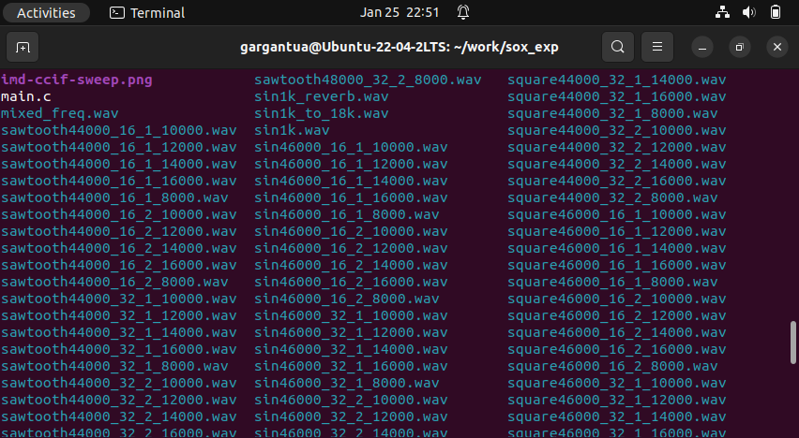
Execution in Phase-2
AFTER RUNNING THE BASH SCRIPT :-

Slide 8
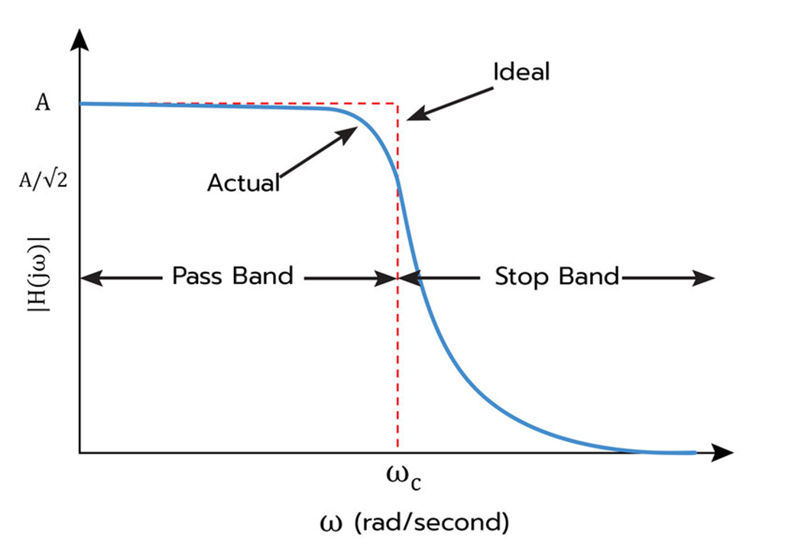
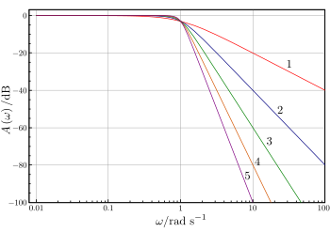
Low-pass Filter
A Low-pass Filter is a filter that is designed to pass all frequencies below a given cut-off frequency. All frequencies higher than the cut-off frequency are attenuated.
Frequency Response:-
Roll-off = -20n dB/decade where n is the filter order
Comparison with Ideal response

Slide 9
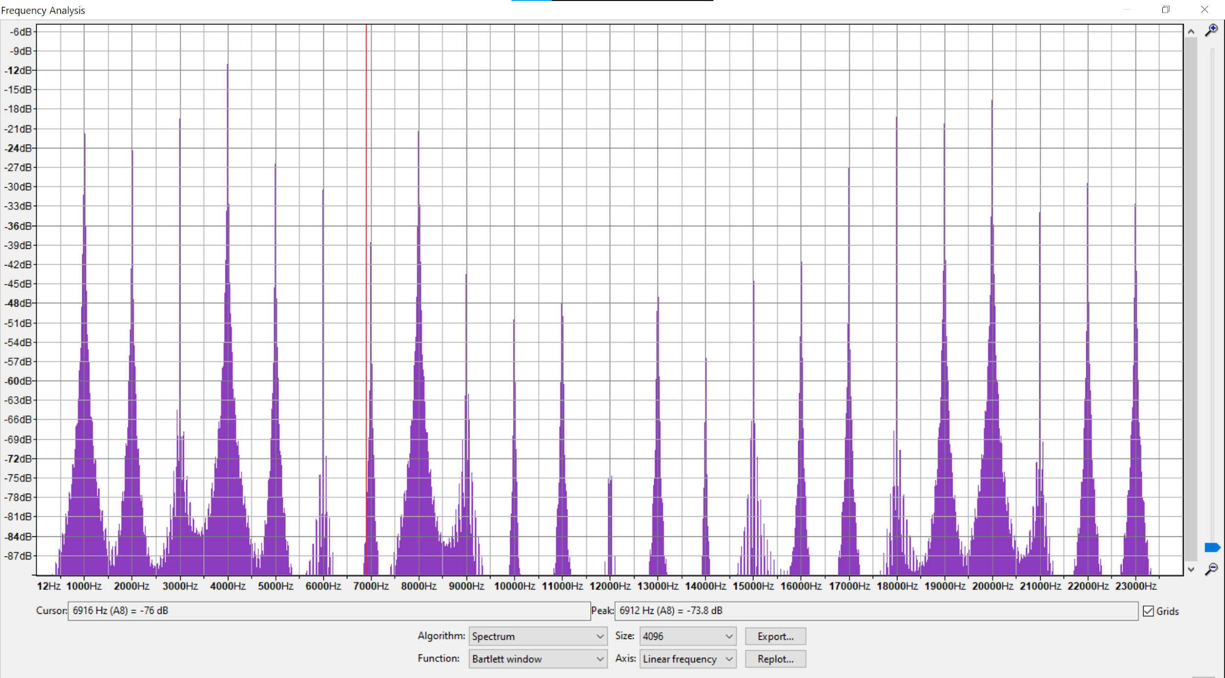
Results for Low Pass Filter
Spectrogram plot of mixed signal(1k,2k,8k,15k,20k) on audacity

Slide 10
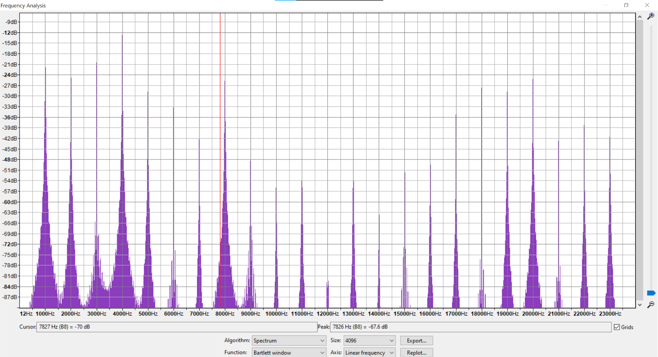
Lowpass : fc=6000 on audacity

Slide 11
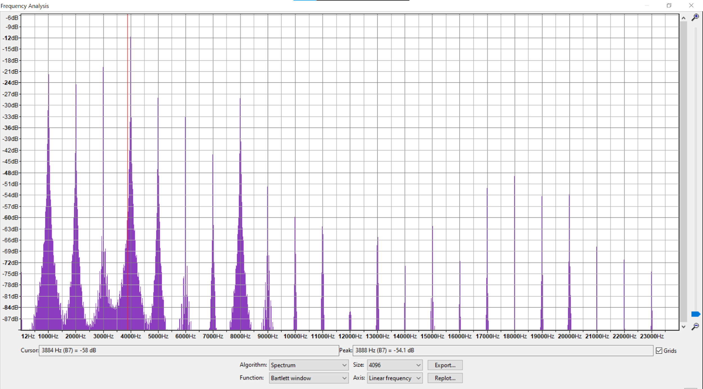
Lowpass : fc=6000 on sox command line, q=0.707

Slide 12
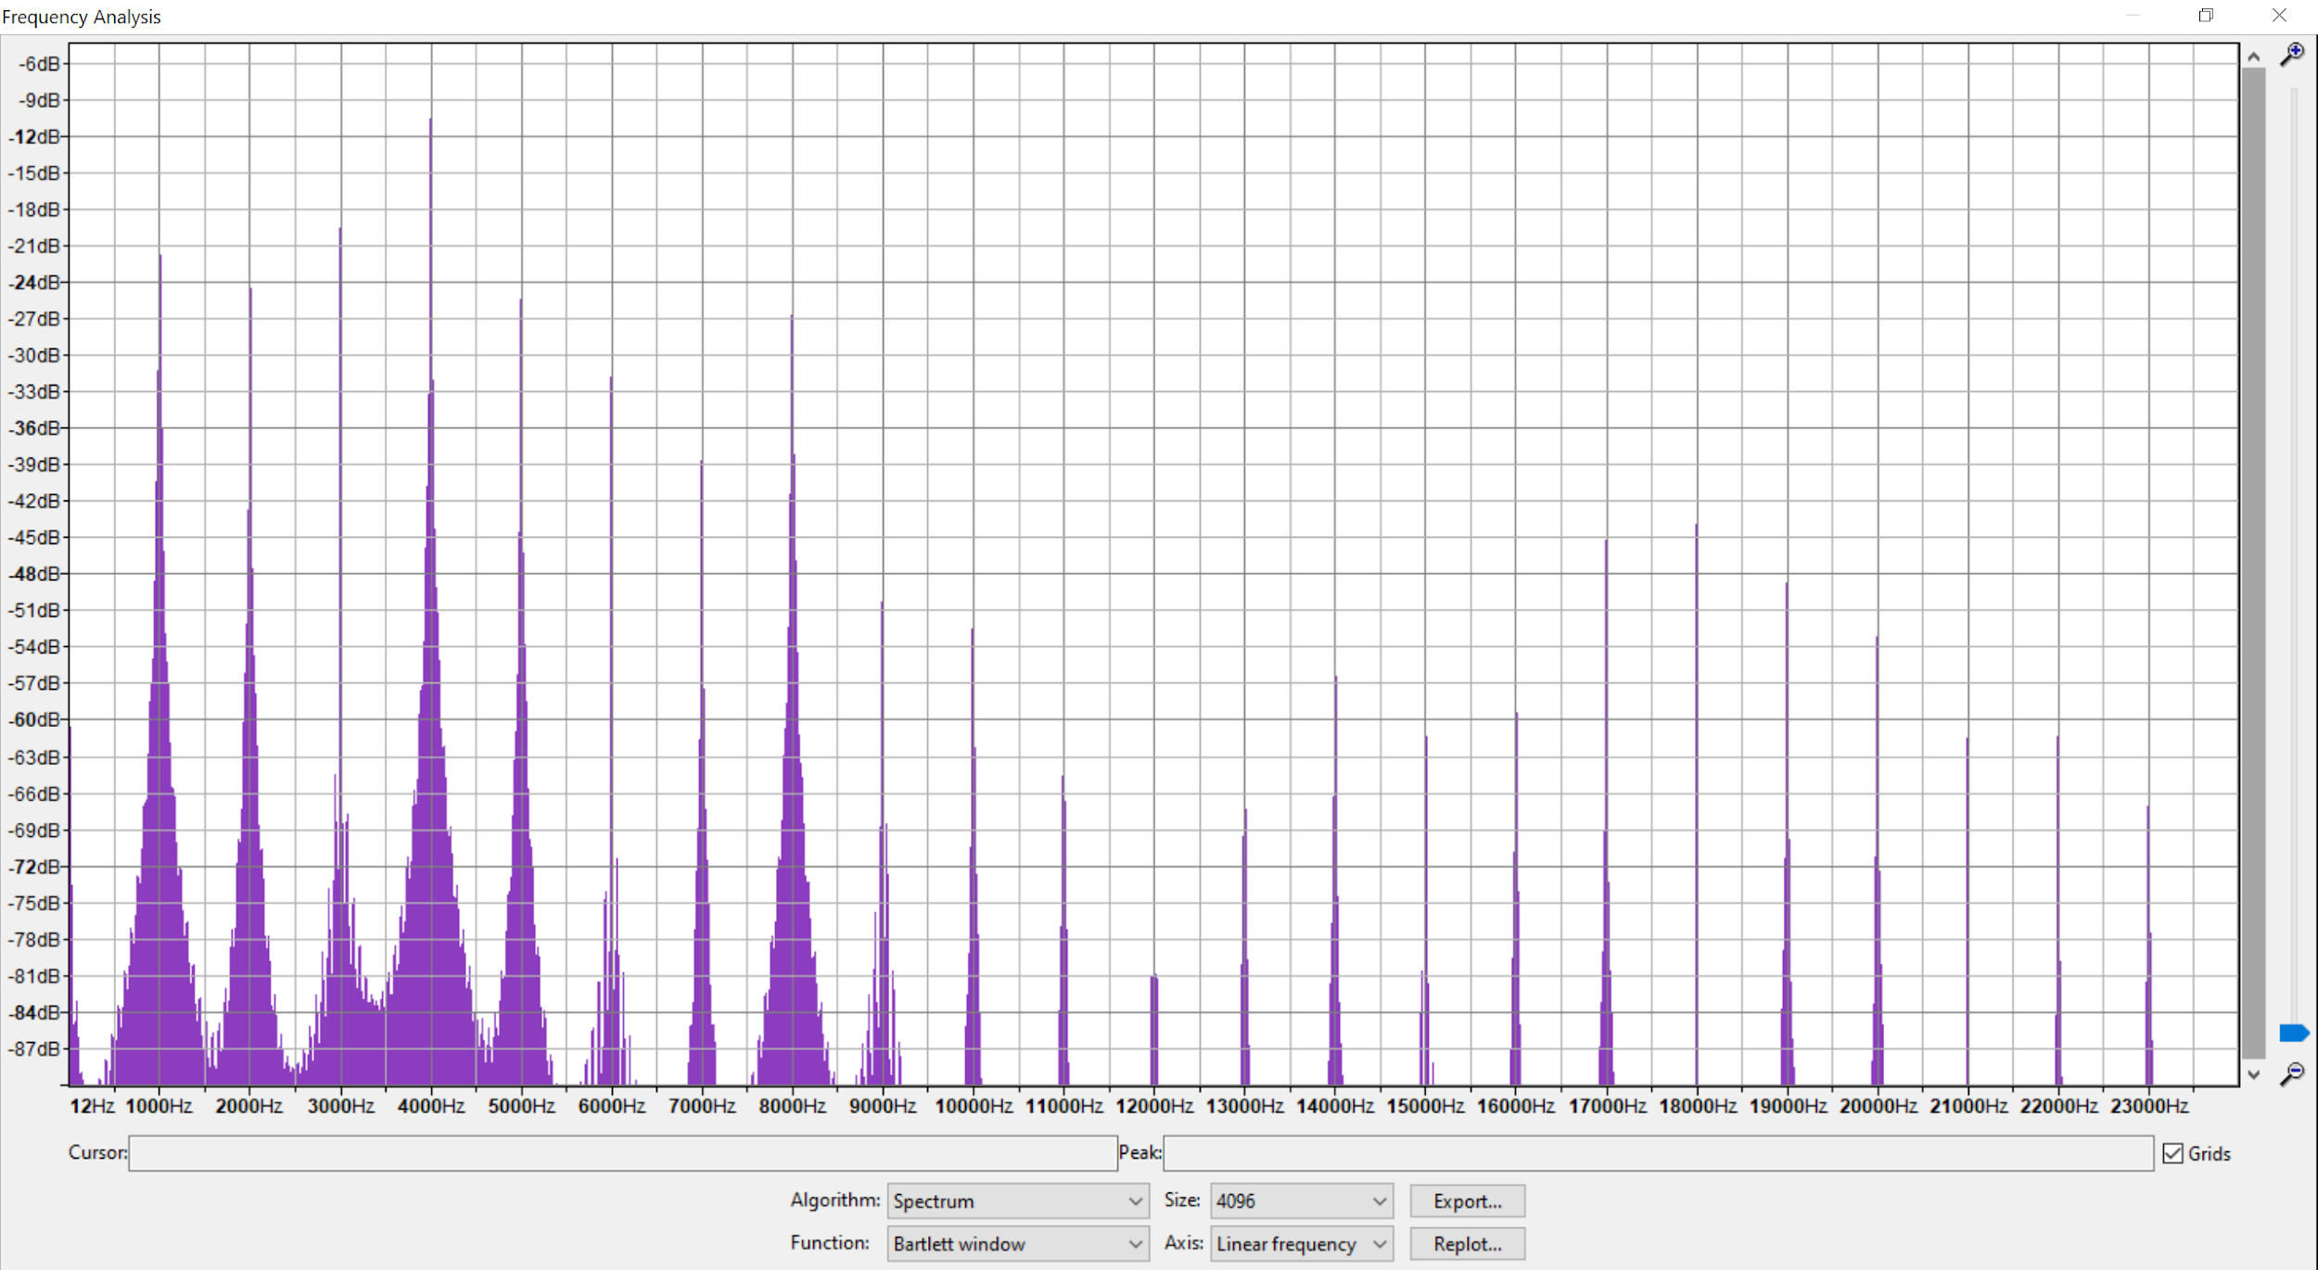
Lowpass : fc=6000 on sox command line, q=0.9

Slide 13
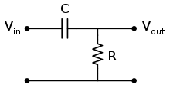
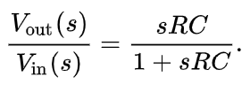
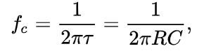
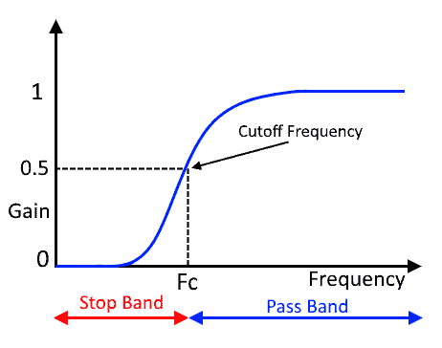
High-pass Filter
A High-pass Filter is a filter that is designed to pass all frequencies above a given cut-off frequency. All frequencies lower than the cut-off frequency are attenuated.
Simple first order high- pass filter
Transfer Function
Cut-off Frequency
Frequency Response

Slide 14
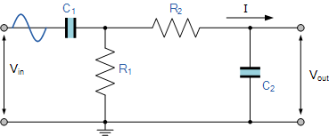
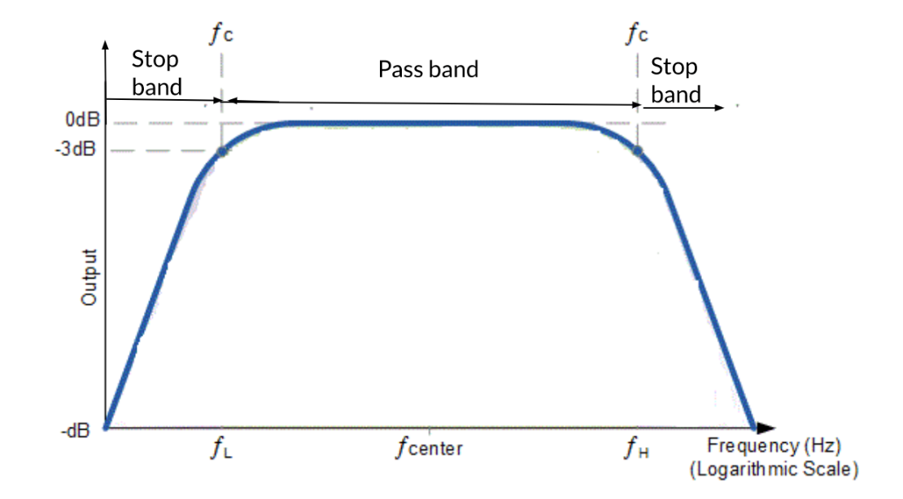
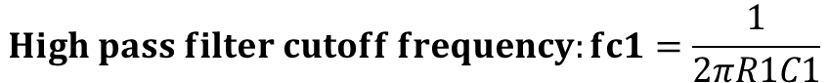
Band-pass Filter
A Band-pass Filter is a filter that is designed to pass all frequencies that fall between its cut-off frequencies fc1 and fc2. All frequencies outside the range are attenuated.
Can be created by combining low-pass and high-pass filters in series.
Simple band-pass filter circuit:-
Frequency Response:-

Slide 15
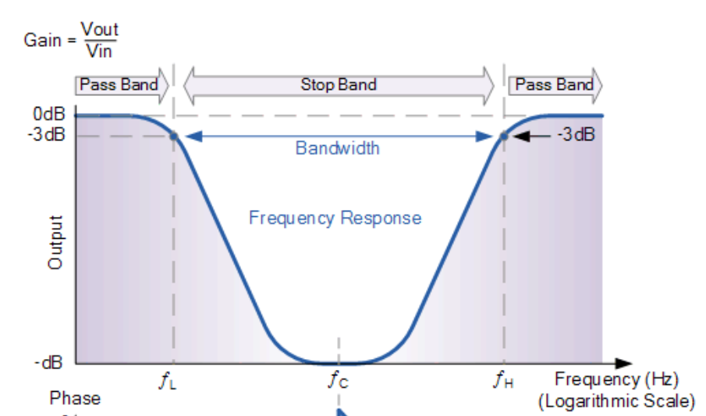
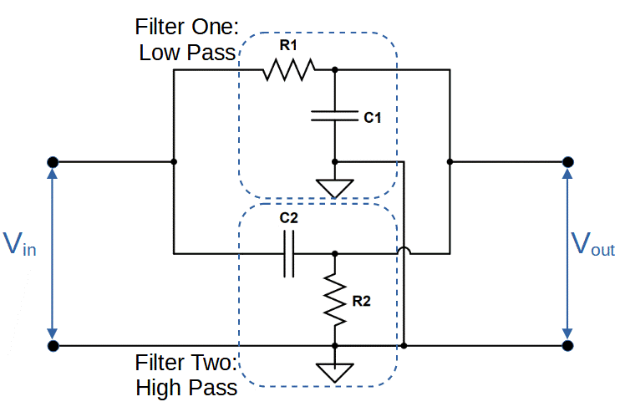
Band-stop Filter
A Band-pass Filter is a filter that is designed to block all frequencies that fall between its cut-off frequencies fc1 and fc2. All frequencies outside the range are allowed to pass through.
Can be created by combining low-pass and high-pass filters in parallel.
Simple band-stop filter circuit:-
Frequency Response:-

Slide 16
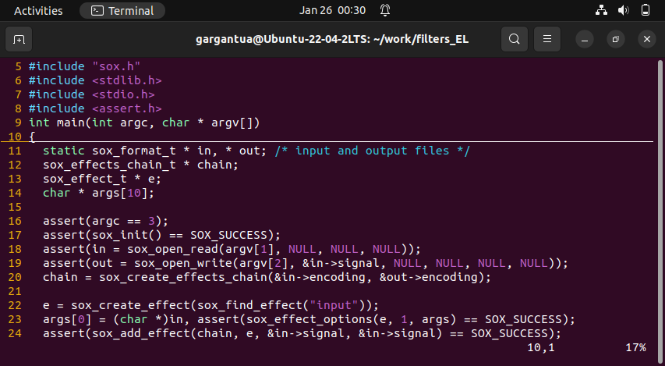
Execution in Phase-2
SAMPLE CODE FOR VOLUME EFFECT:-

Slide 17
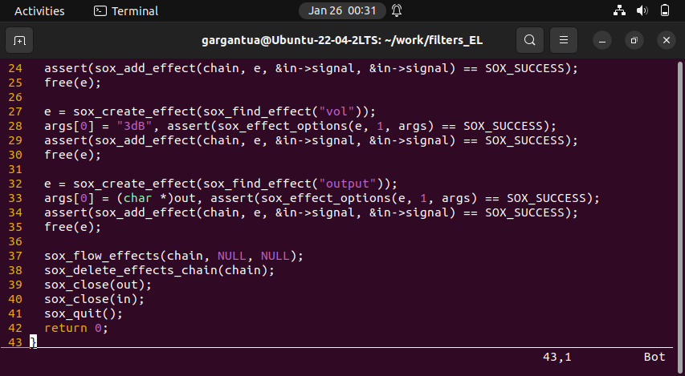
Execution in Phase-2

Slide 18
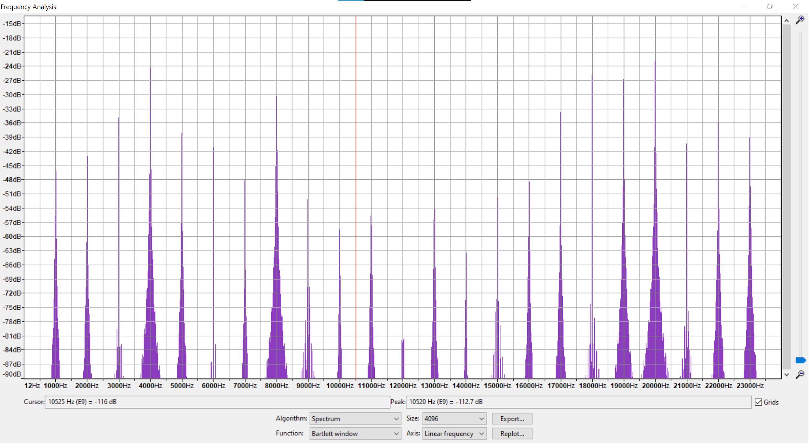
Highpass : fc=10000 on audacity

Slide 19
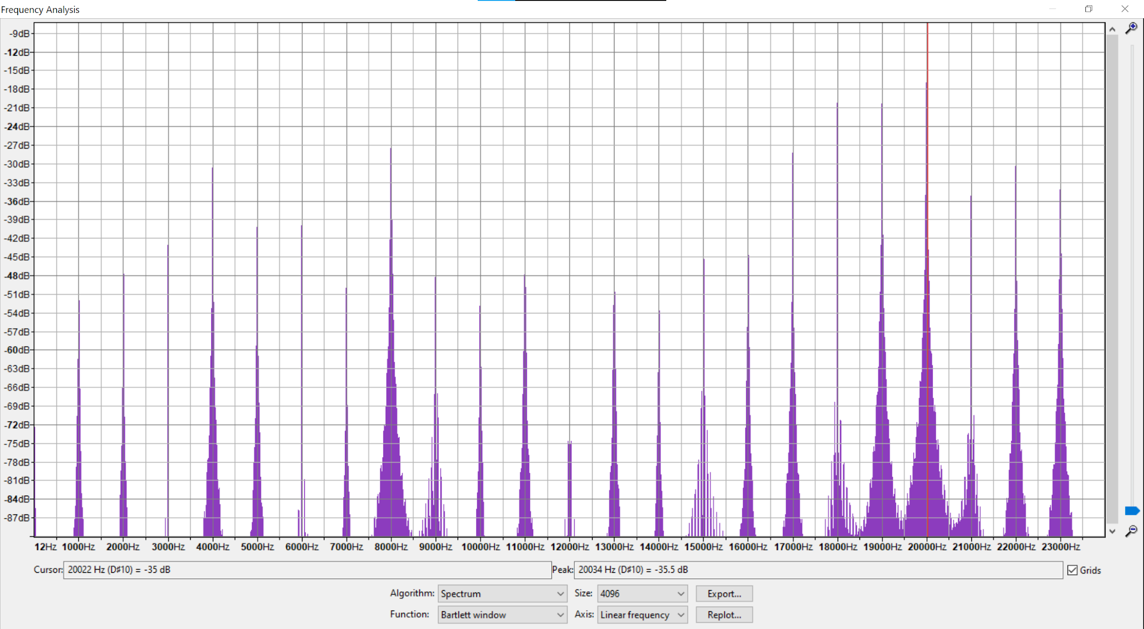
highpass : fc=10000 on sox command line, q=0.707

Slide 20
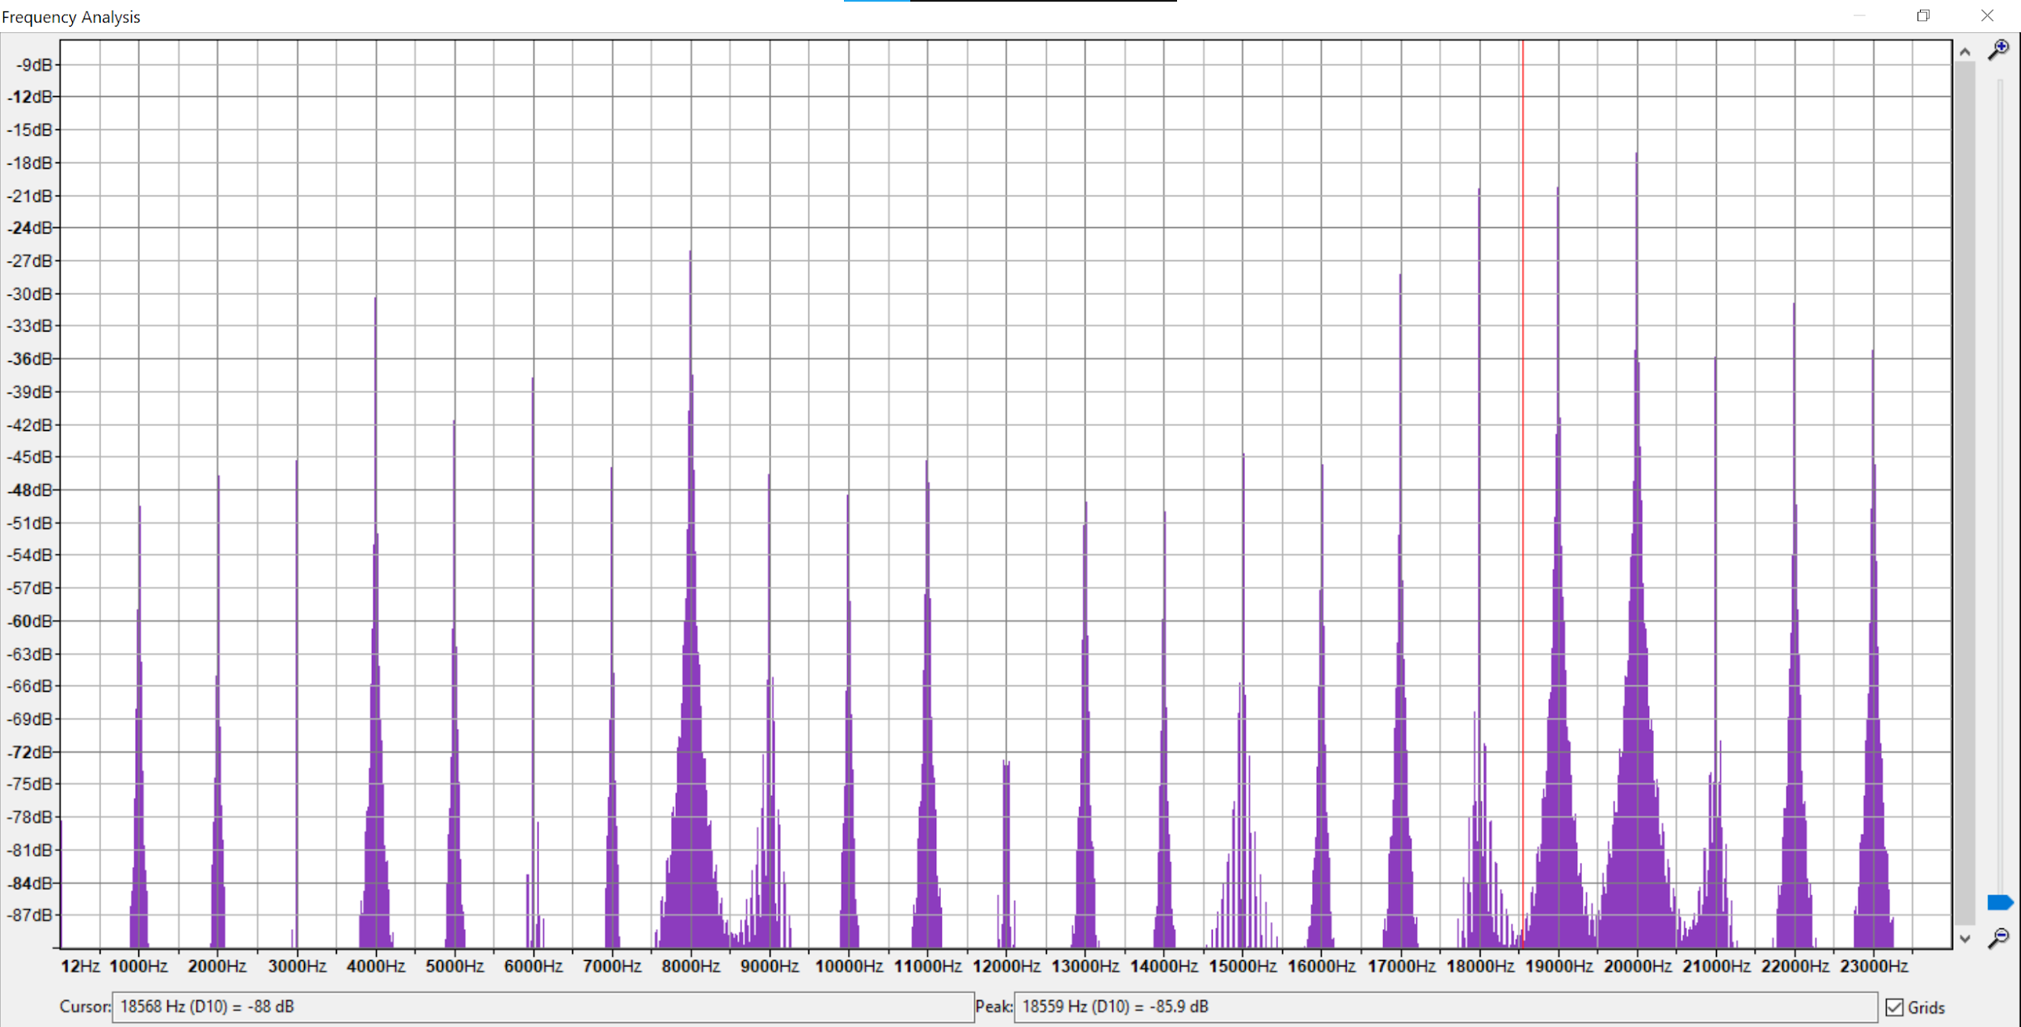
highpass : fc=10000 on sox command line, q=0.9

Slide 21
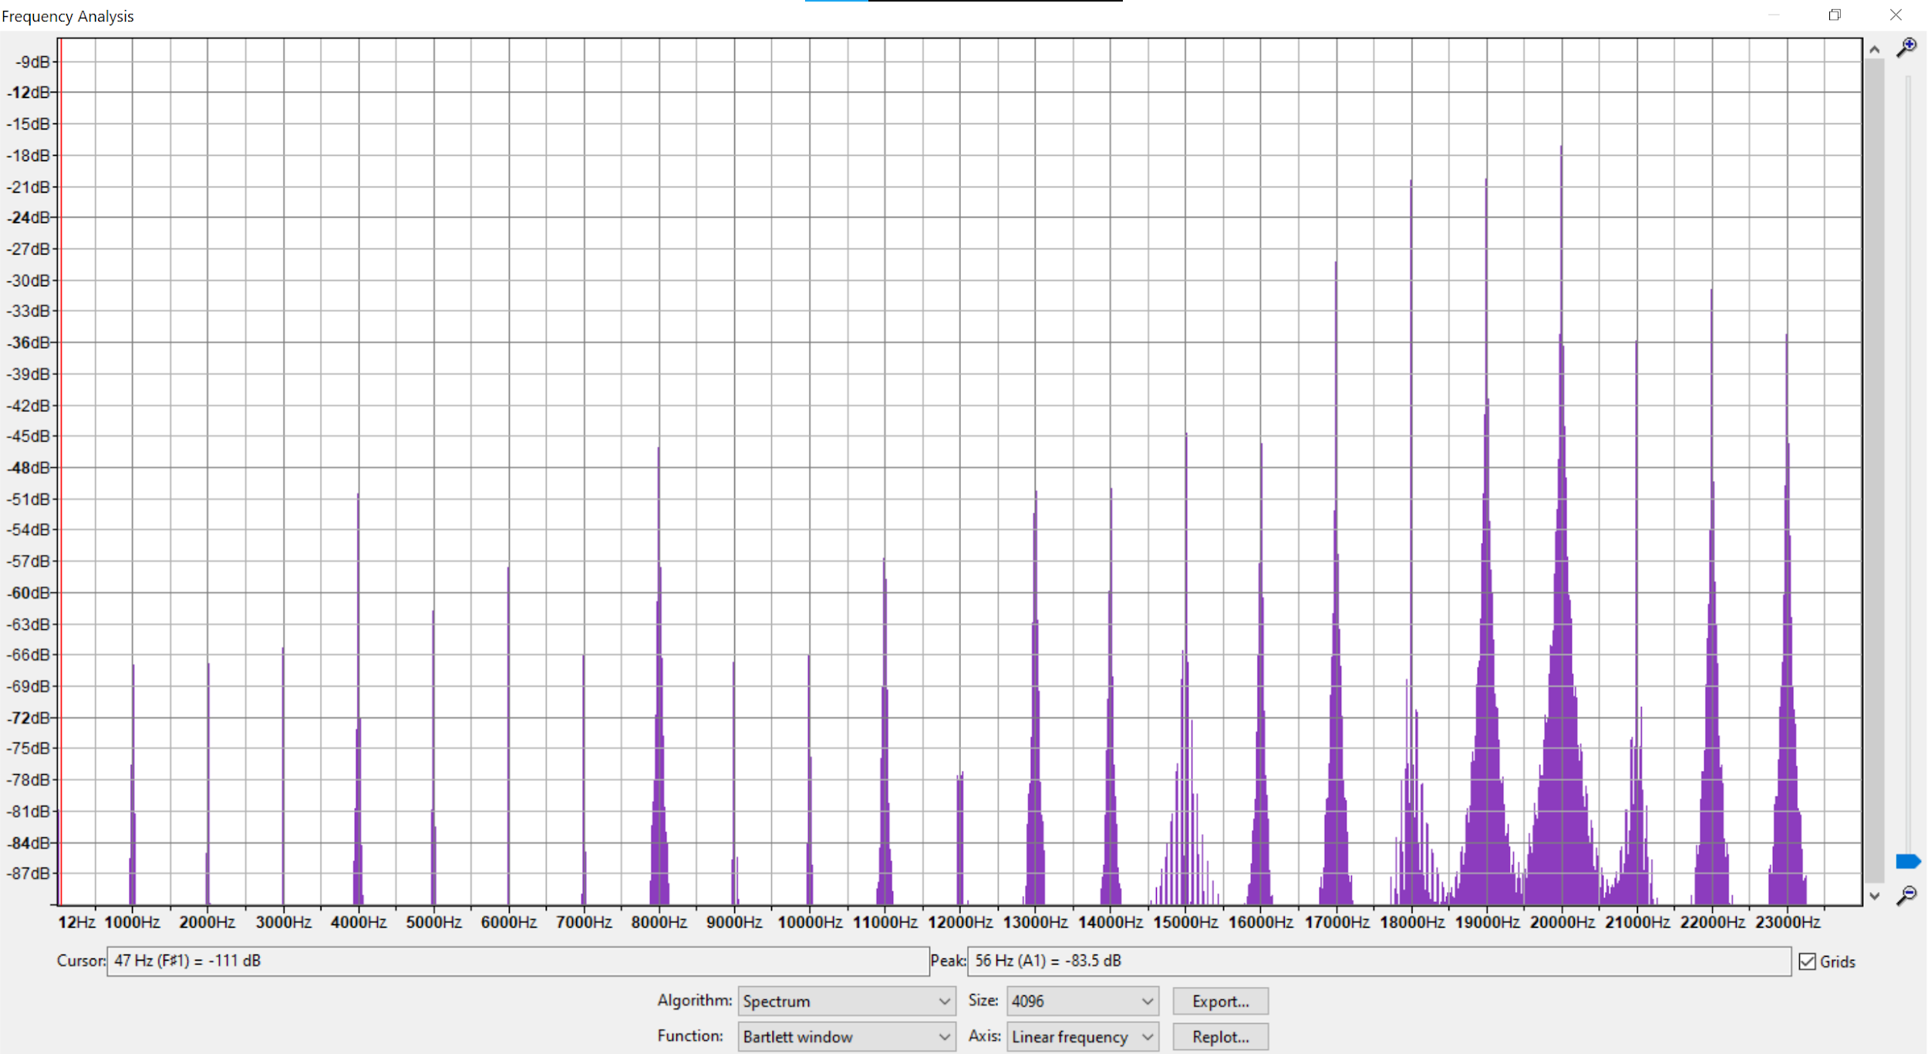
Highpass : fc=10k on audacity and using Graphic EQ and attenuating frequencies below 10k

Slide 22
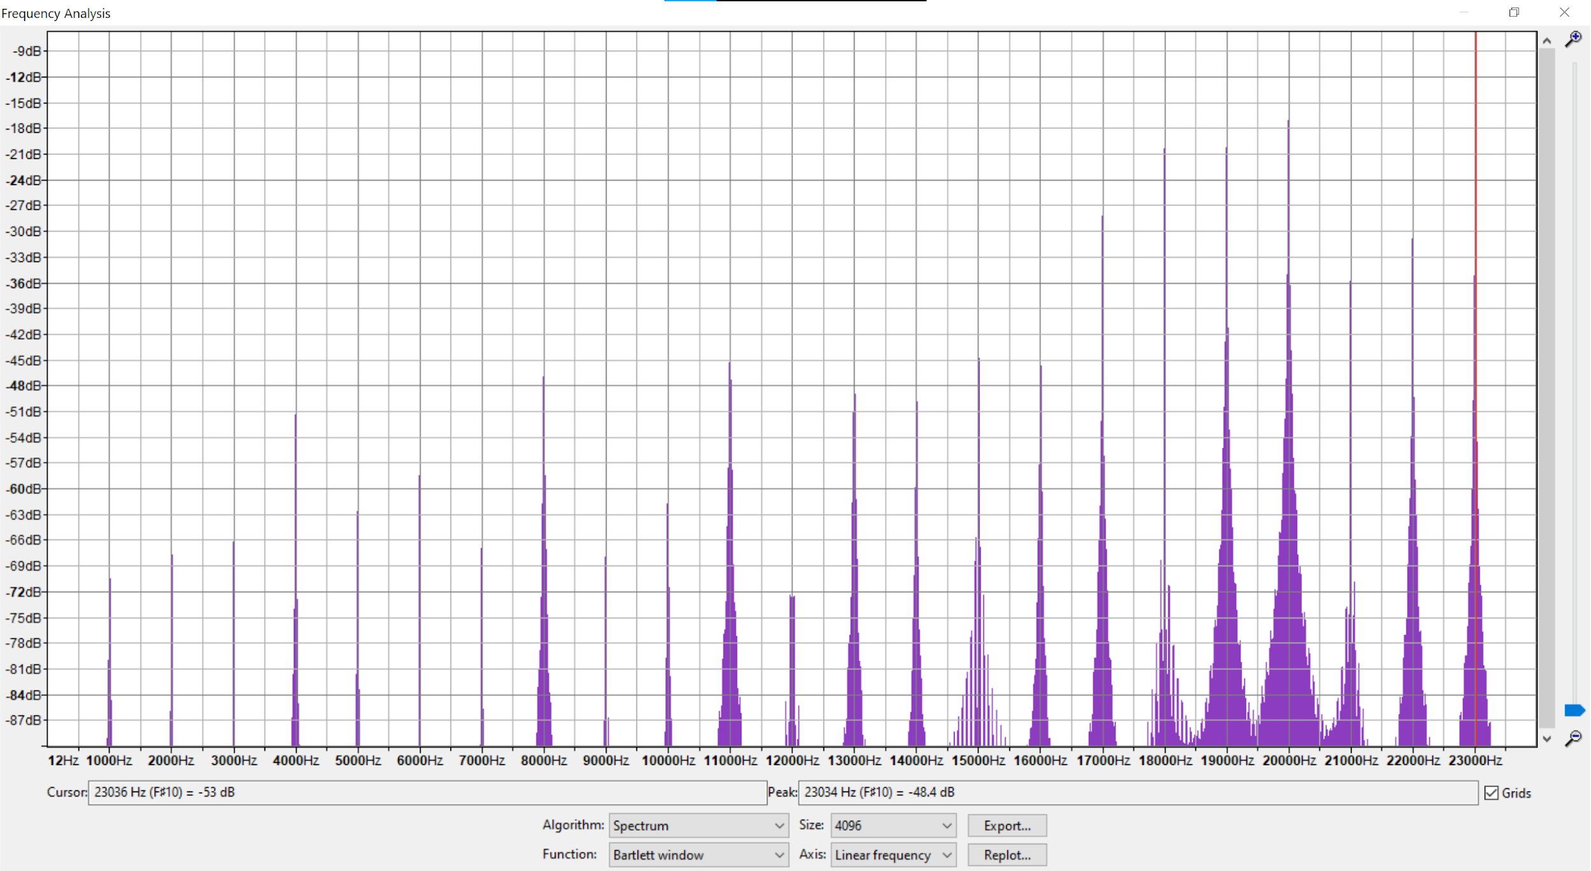
Highpass : fc=10k on audacity and using filter curve and attenuating frequencies below 10k

Slide 23
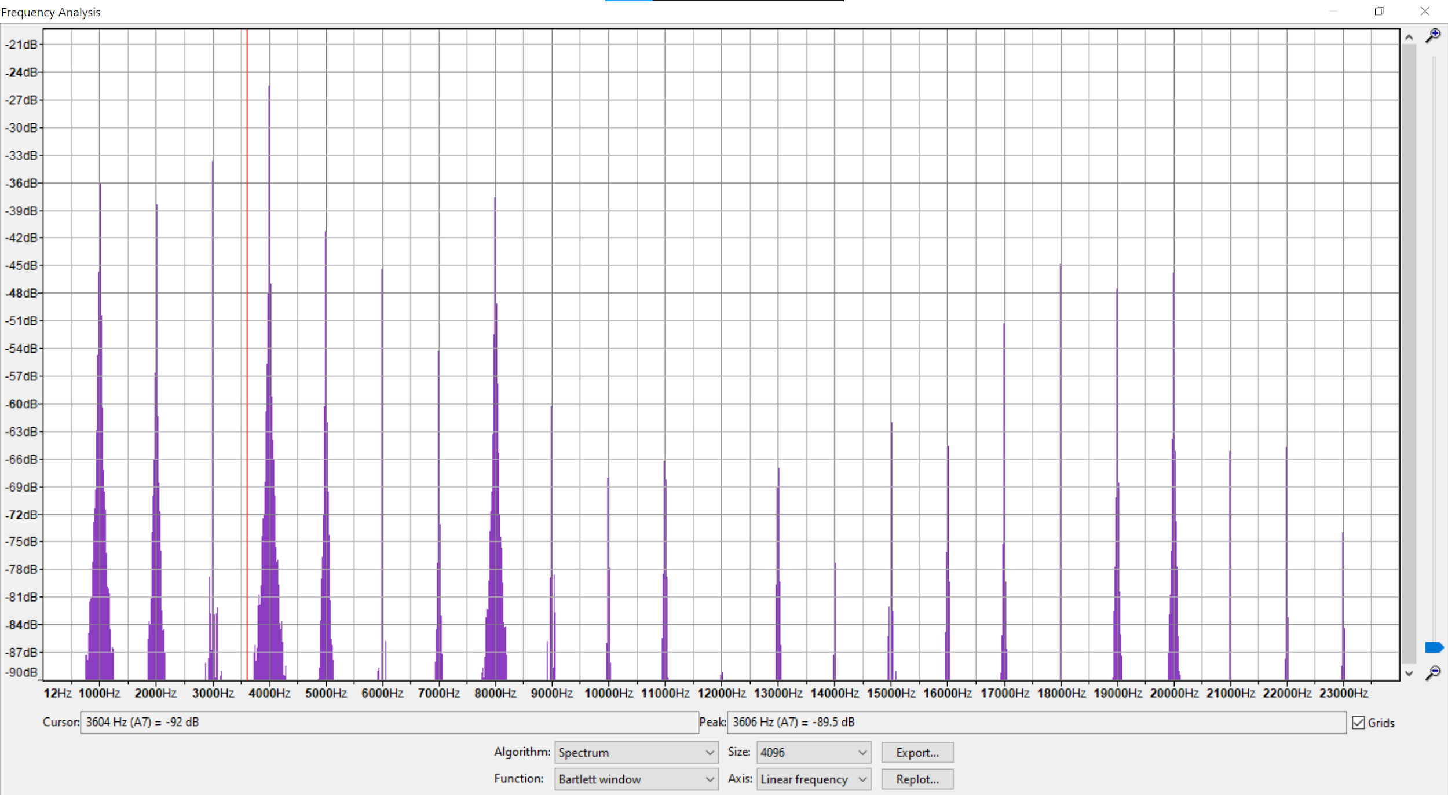
bandpass : 2k to 10k on sox command

Slide 24
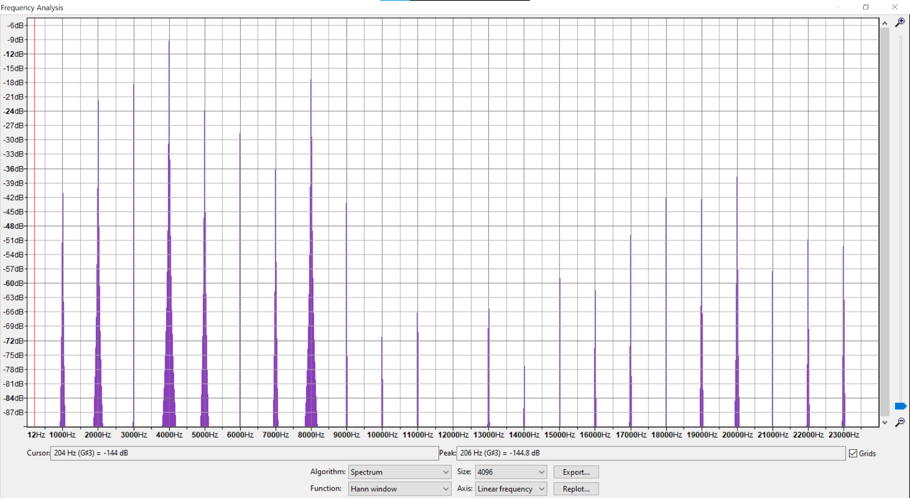
bandpass : 2k to 10k on audacity using filter curve

Slide 25
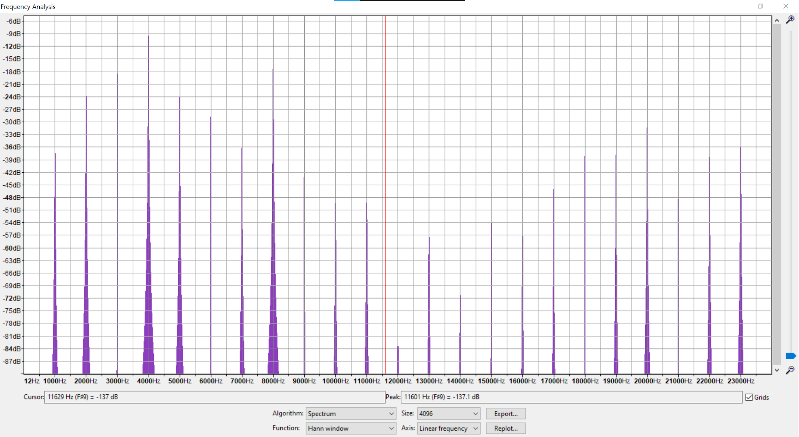
bandpass : 2k to 10k on audacity using graphic EQ

Slide 26
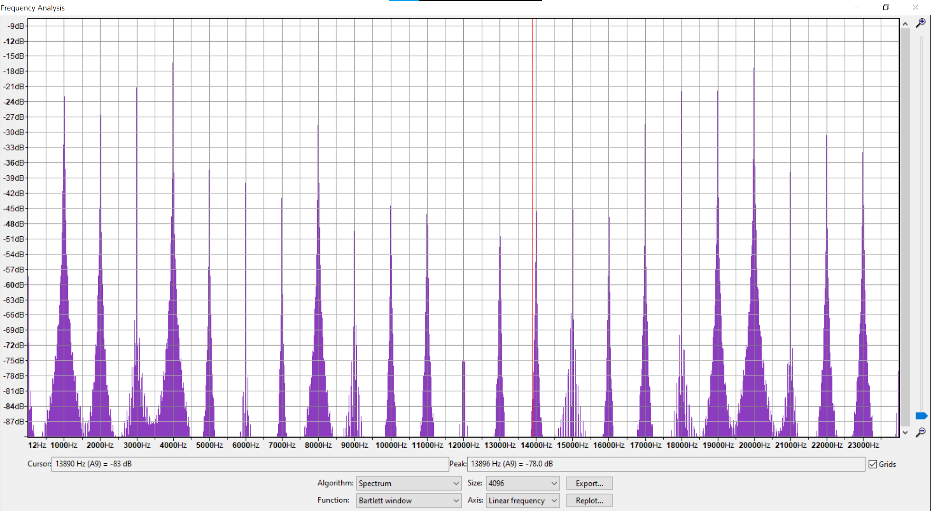
bandreject : 6k to 17k on sox(but used the command: sox mix_1_4_8_15_20k.wav output_bandreject.wav bandreject 6000 0.707q
Not so good response, lets try cascading lowpass and highpass.

Slide 27
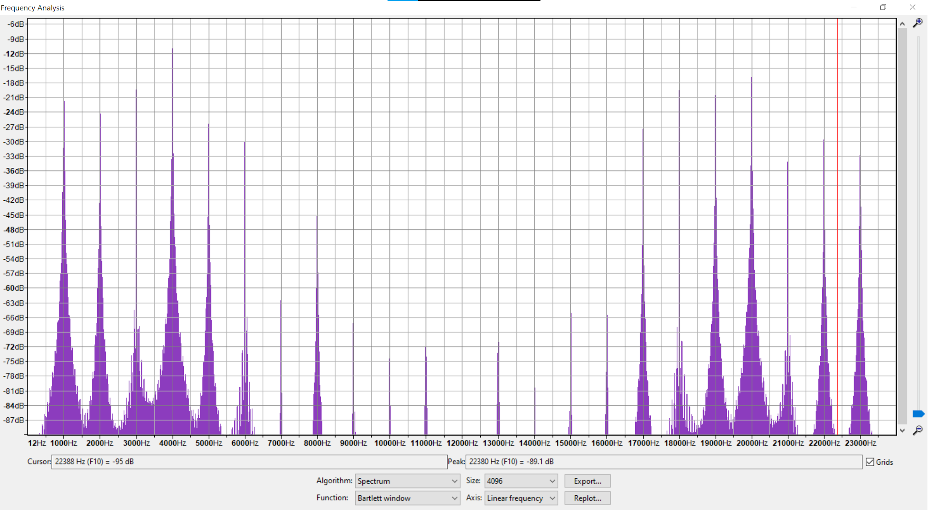
bandreject : 6k to 17k on audacity using filter curve EQ

Slide 28
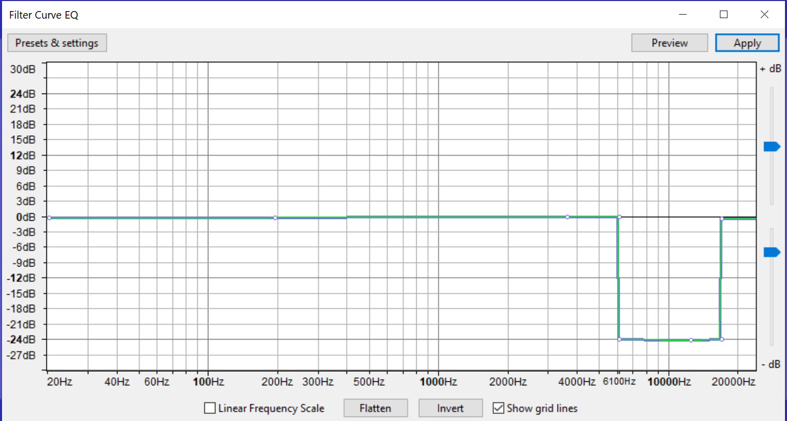

Slide 29
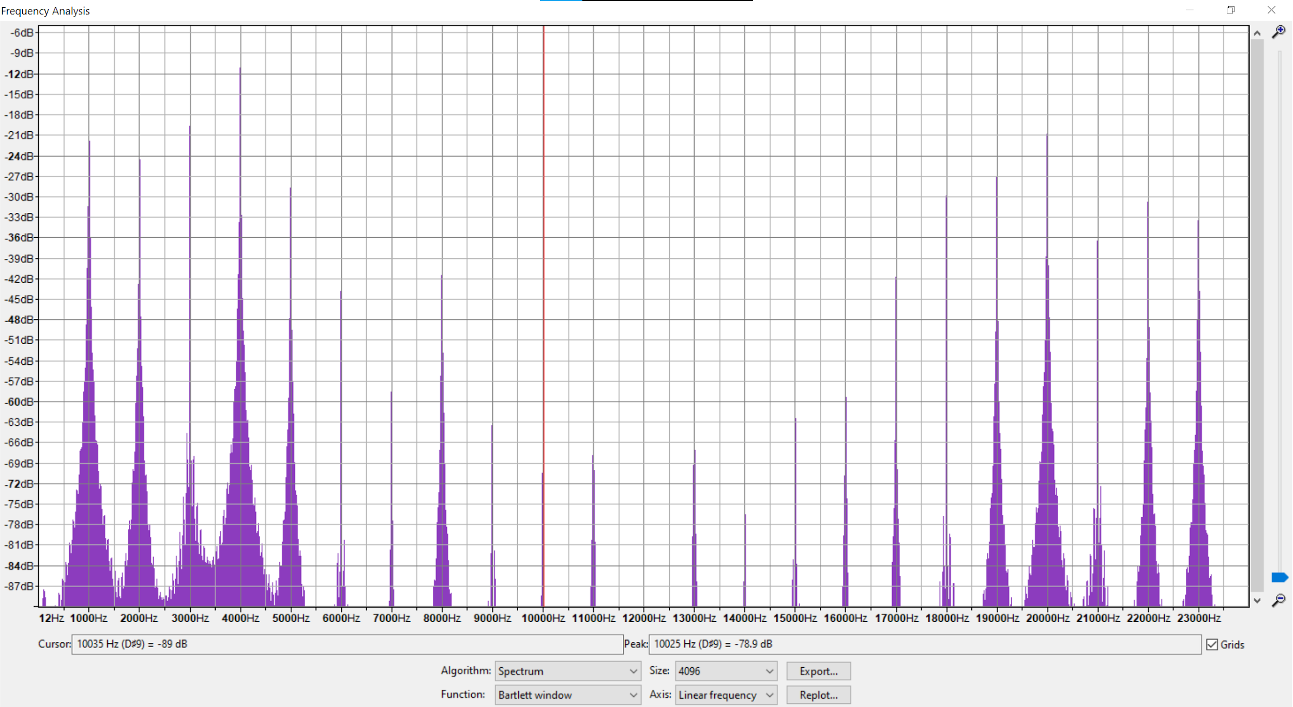
bandreject : 6k to 17k on audacity using Equaliser of Audacity

Slide 30
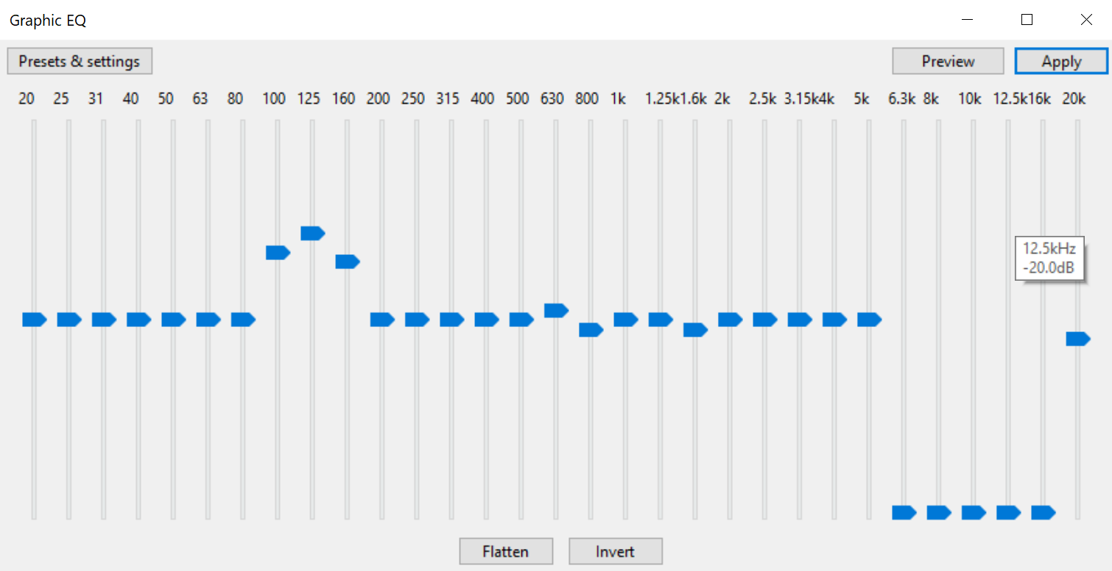

Slide 31
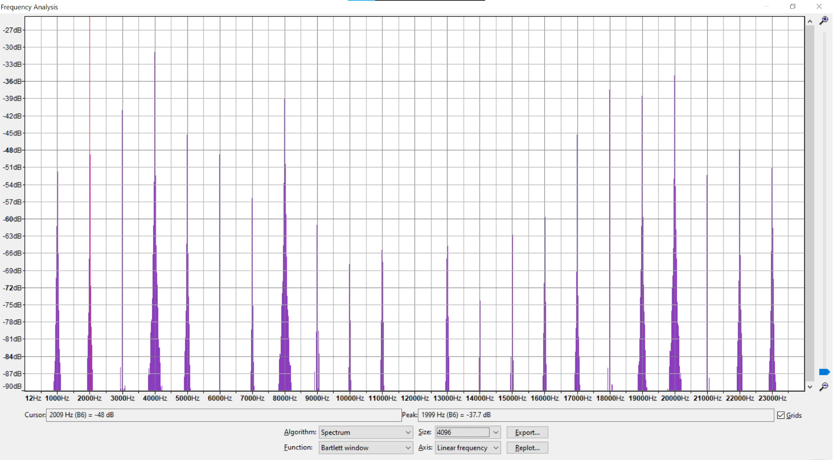
bandreject : cascading lowpass and highpass, first lowpass 6k then highpass 17k
Even, if you reverse the order, you will get the same output.

Slide 32
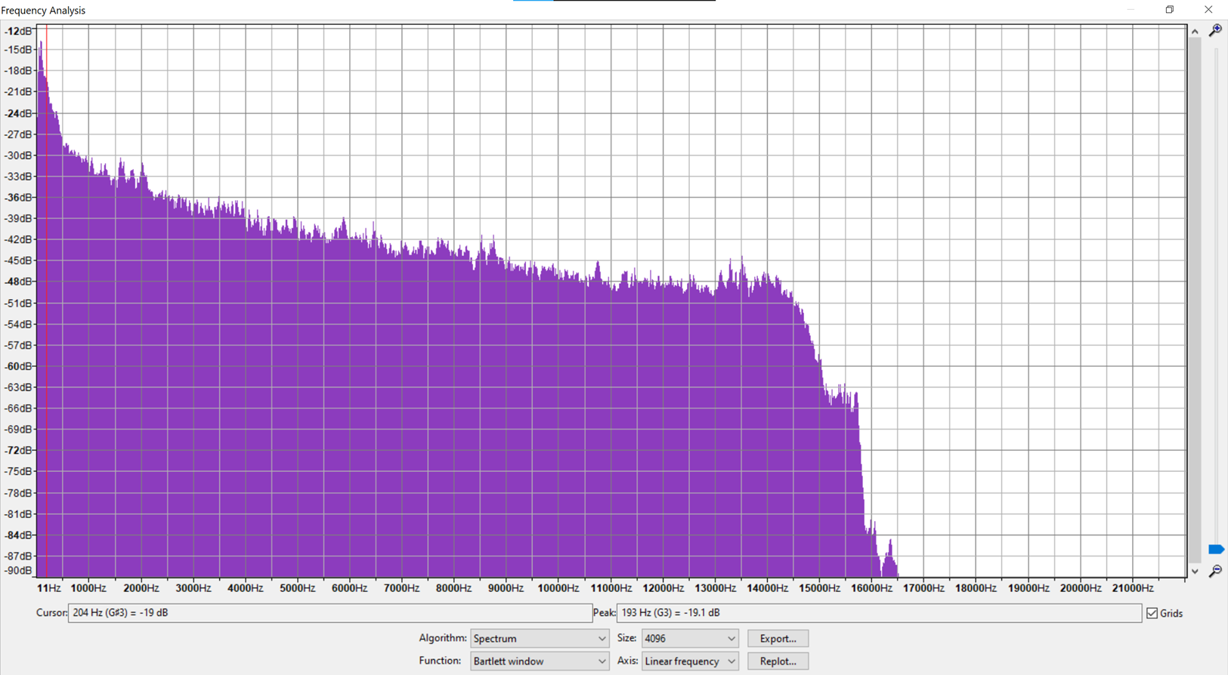
Sample audio file

Slide 33
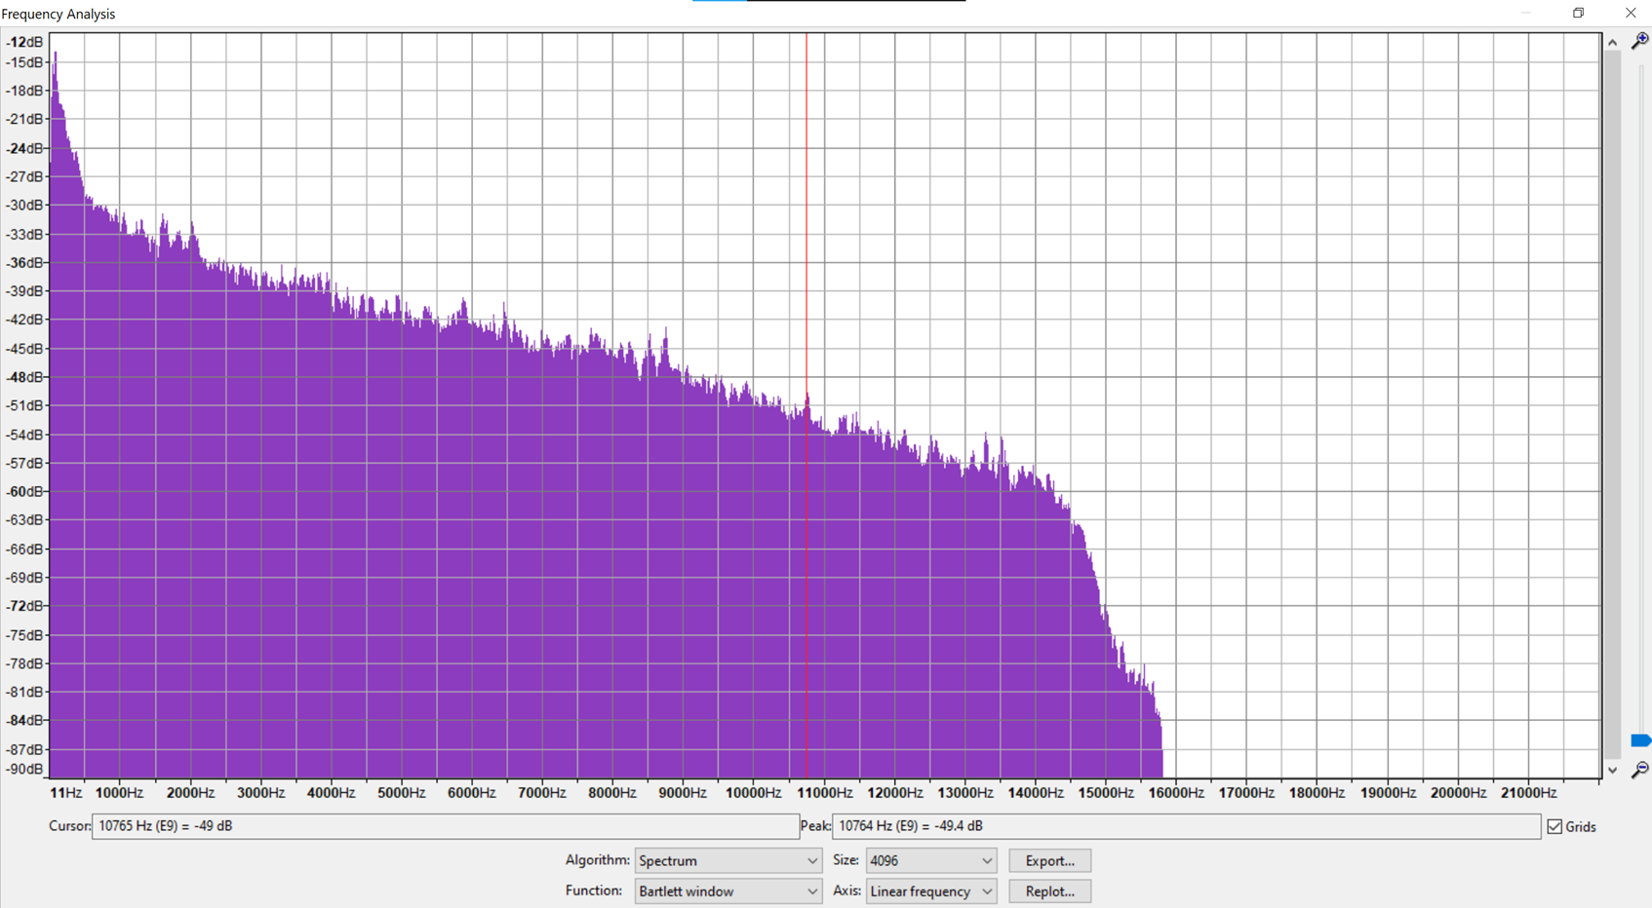
Lowpass: cutoff-freq: 10kHz, 0.707

Slide 34
Highpass: cutoff-freq: 4kHz, 0.707

Slide 35
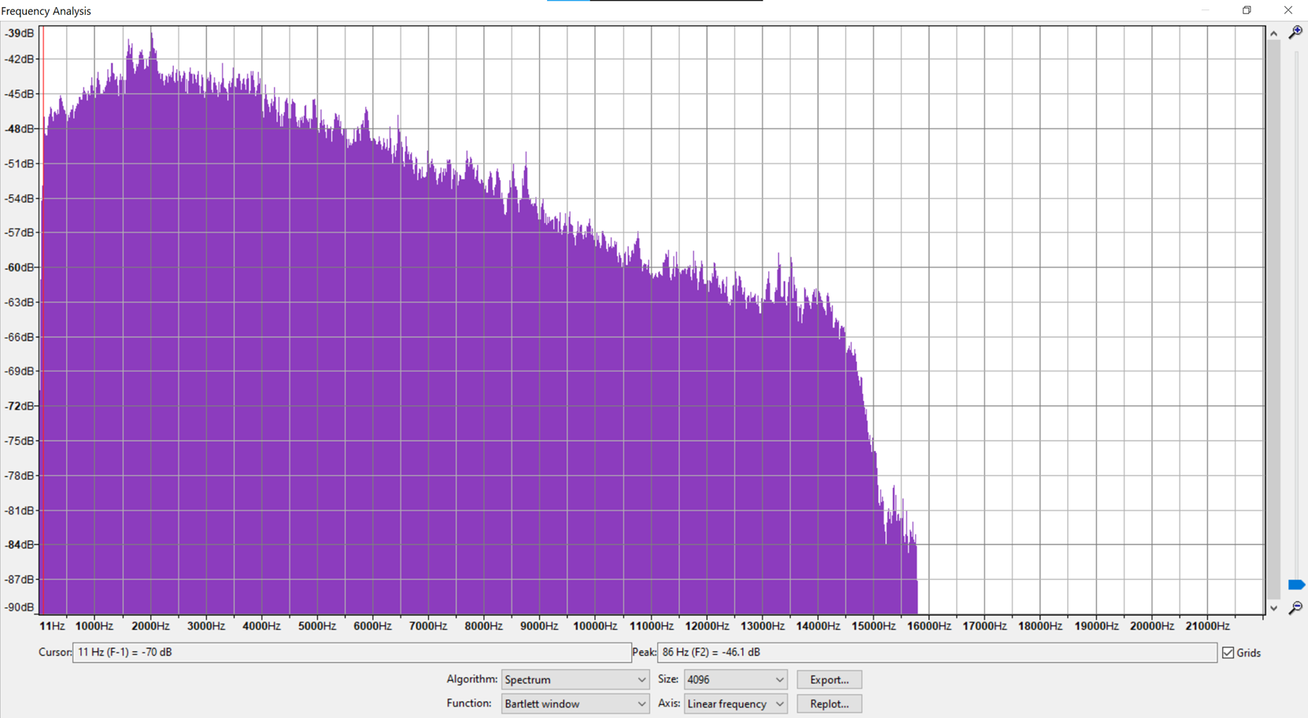
Bandpass: cutoff-freq: 4kHz and 8kHz

Slide 36
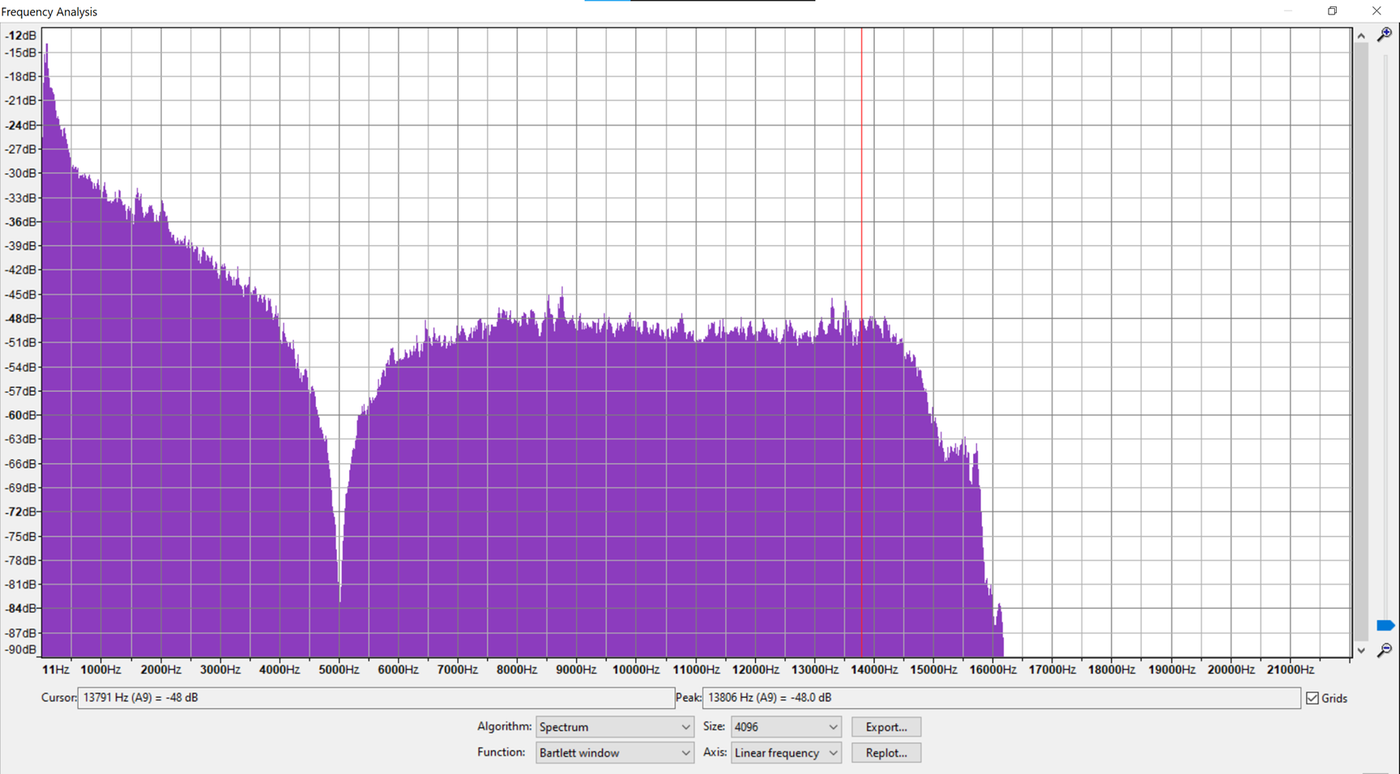
Bandreject: cutoff-freq: 5kHz at 0.707q

Slide 37
References
GITHUB REPOSITORY OF “LIBSOX” LIBRARY: https://github.com/dmkrepo/libsox
SOX LIBRARY DOCUMENTATION: https://fossies.org/dox/sox-14.4.2/libsox_8c.html
MAN PAGES (LINUX) OF “LIBSOX”: https://linux.die.net/man/3/libsox
LIBSOX TUTORIAL: https://www.audiosciencereview.com/forum/index.php?threads/howto-sox-audio-tool-as-a-signal-generator.4242/

